Slide 1

Finals
Aileen Benz Sabellon

Slide 2
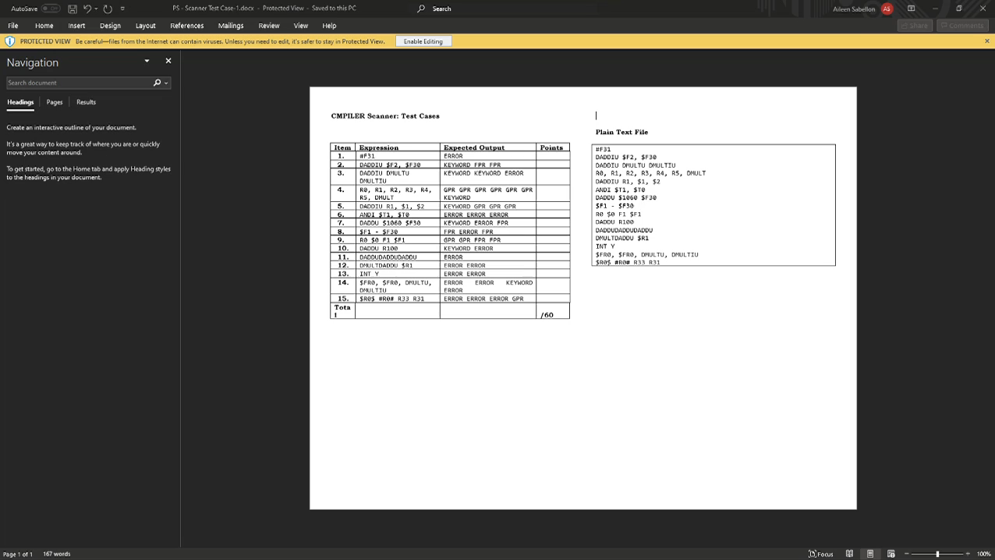
HANDS ON IMPLEMENTATION

Slide 3
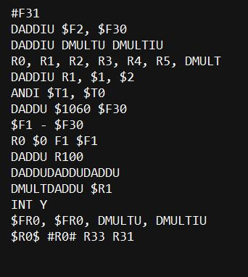
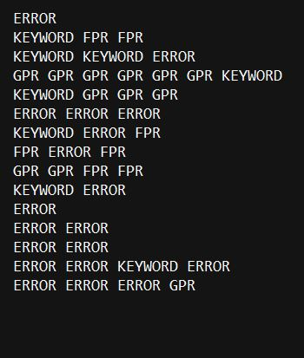
INPUT OUTPUT

Slide 4
Lexical Analyzer

Slide 5
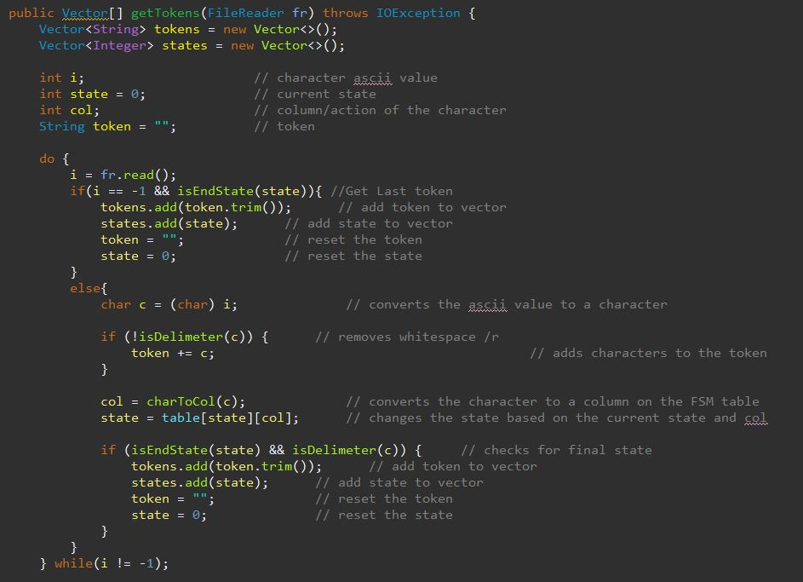
TOKEN CREATION
Token is created using Maximal Munch Algorithm.
Maximal Munch Algorithm is used to match the longest possible prefix of each texts
All characters are scanned from the file.
And then all characters are assigned to a state.
The states are the tokens that are accepted by the program.
This will repeat until all characters are exhausted.

Slide 6
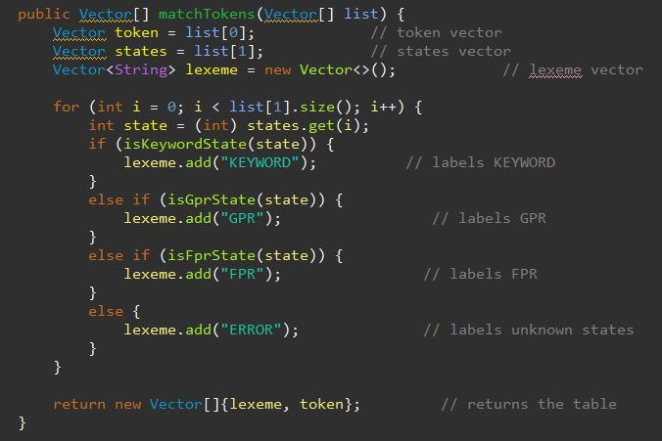
TOKEN CREATION
Once each final states of tokens have been determined,
Match the tokens based on the keywords provided.
(OPTIONAL, ZERO_OR_MANY, ZERO_OR_MANY, EPSILON, UNION, LEFT_PAR, RIGHT_PAR, ALPHANUM, REJECT)

Slide 7
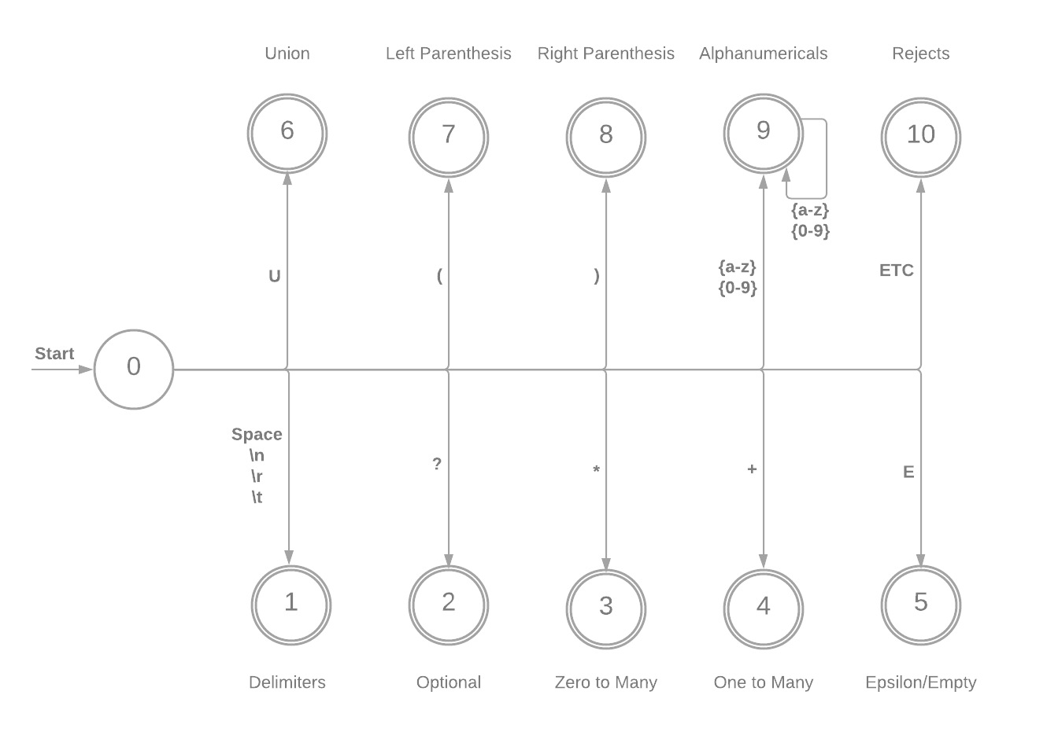
FSM (FSM DIAGRAM)
Final States Accepts: T = {(a-z), (0-9), *, +, ?, E, U, (,), Errors, Whitespaces}
NOTE:
ETC = Exhausts all other inputs.
Delimiters are accepted but ignored.
Delimiters are also called as “Whitespaces”

Slide 8
PARSER

Slide 9
LL(1) GRAMMAR

Slide 10
LL(1) GRAMMAR

Slide 11
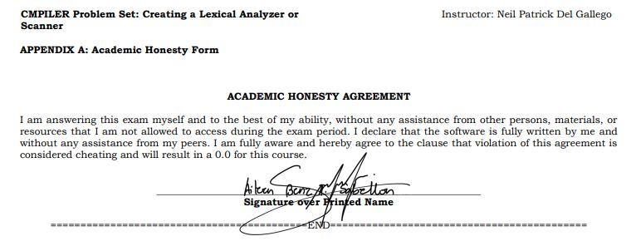
FINALS: Honesty Form

